Slide 1


Political Discourse in the Digital Age
An exploration of online polarization. We will examine its causes, effects, and potential solutions. This presentation provides an overview of the key trends shaping online political discourse and will focus on actionable insights for mitigating its negative impacts.
Vikas Chauhan
Rahul Behara
Ritesh Salunkhe
Prateek Bajpai

Slide 2





Introduction: Political Discourse & Online Polarization
Political discourse
Public exchange of ideas on governance.
Why it matters
Shapes policy, civic engagement, and social cohesion.
Online polarization
Amplified echo chambers and filter bubbles.
Case study objectives
Analyze trends, impacts, and potential solutions.

Slide 3




Background & Motivation
Political Polarization
Echo Chambers
Social Media Influence
Homogenous networks reinforcing existing beliefs.
Divergence towards ideological extremes.
Rapid dissemination of information, both accurate and misleading.

Slide 4
Dataset Overview
Source
Timeframe
Keywords
Demographics
Twitter API (now X).
Oct 2022 - Mar 2023.
Politics, Elections, Social Issues.
Limited user profile data.

Slide 5




Methodology
Data Collection
API calls, public datasets.
NLP
Sentiment analysis, topic modeling.
Network Analysis
Identifying echo chambers.
Statistical Analysis
Correlation between activity and real-world events.

Slide 6
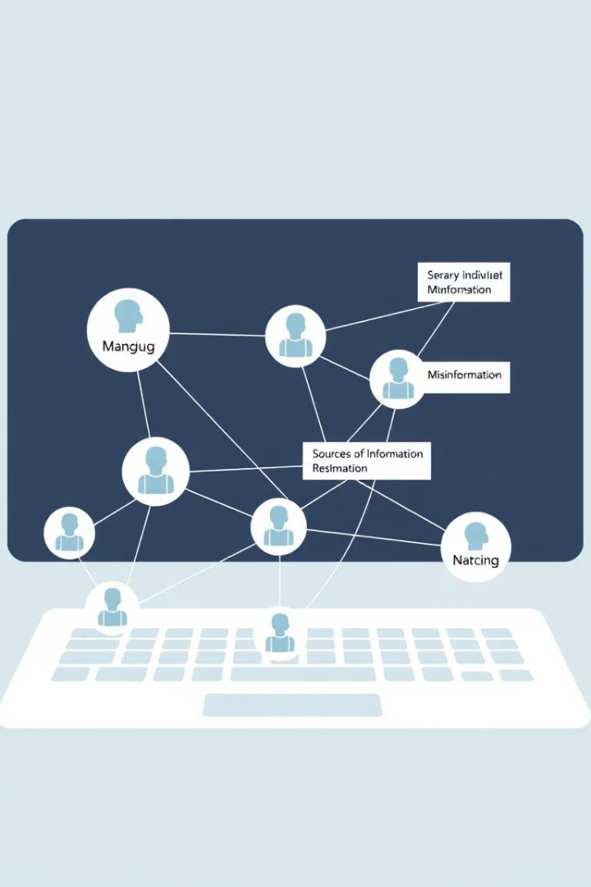
Key Findings & Polarization Indicators
Prominent echo chambers
Network segregation
Limited cross-ideological interaction.
Clustering around specific hashtags/keywords.
Correlation
Online activity precedes real-world events.

Slide 7
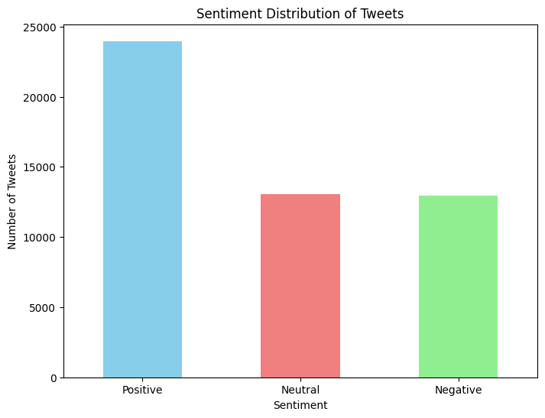
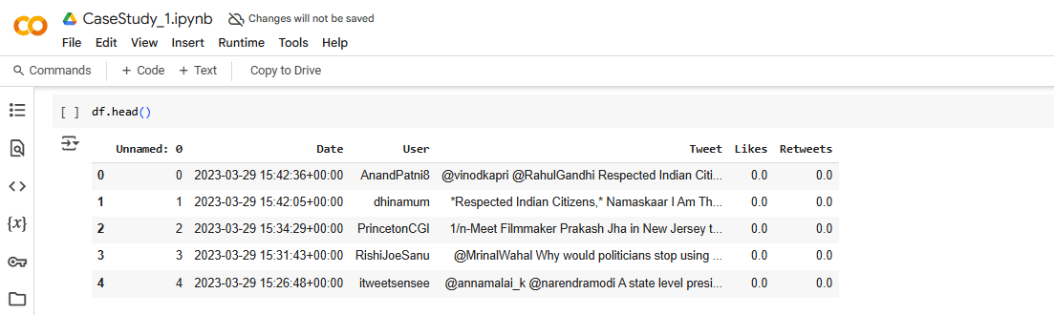
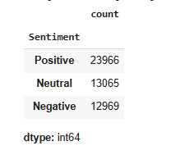
Key Findings.
Sentiment Analysis Results.
Positive Tweets: 23,966 (~48%)
Neutral Tweets: 13,065 (~26%)
Negative Tweets: 12,969 (~26%)
Insight:
Nearly half of the tweets are positive, suggesting a significant amount of
supportive or optimistic discourse.
A balanced split between neutral and negative tweets indicates mixed
opinions and possible polarization.

Slide 8
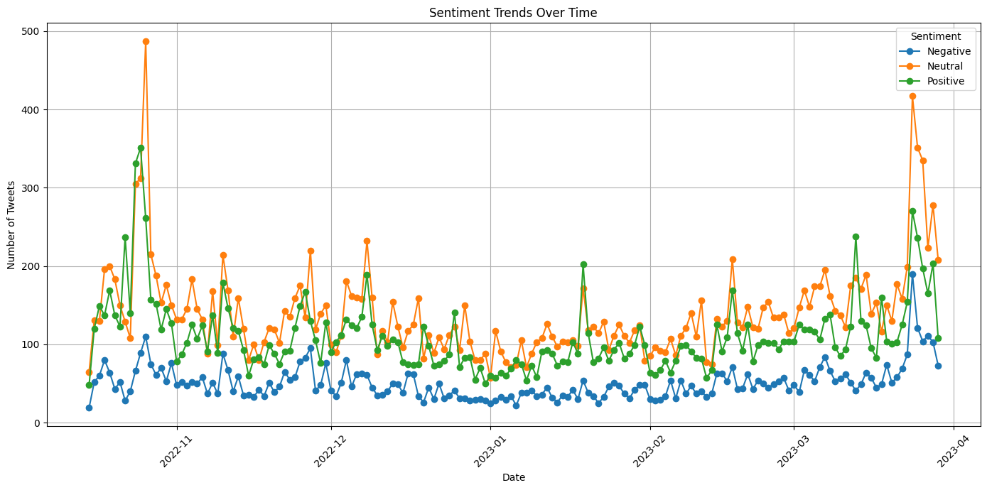
Key Findings.

Slide 9
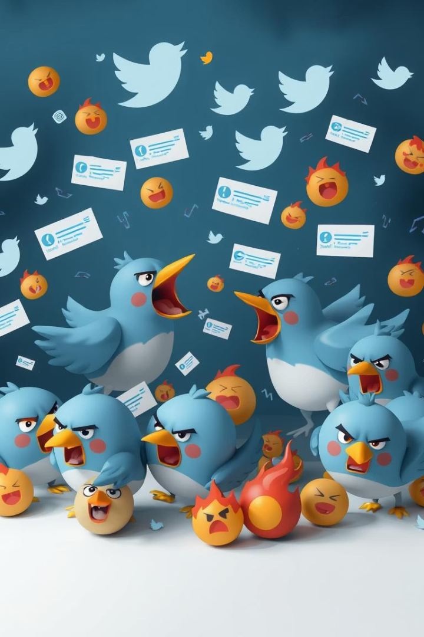
Case Study: Hashtag War
1
Timeline
Tracking hashtag usage.
2
Content analysis
Identifying key narratives.
3
User engagement
Retweets, likes, and replies.
4
Bot activity
Detection of inauthentic accounts.

Slide 10
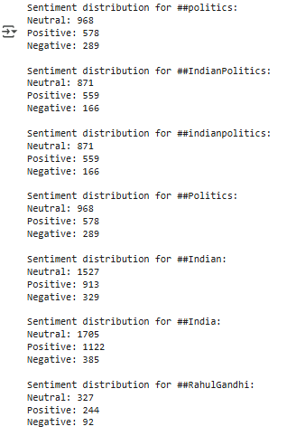
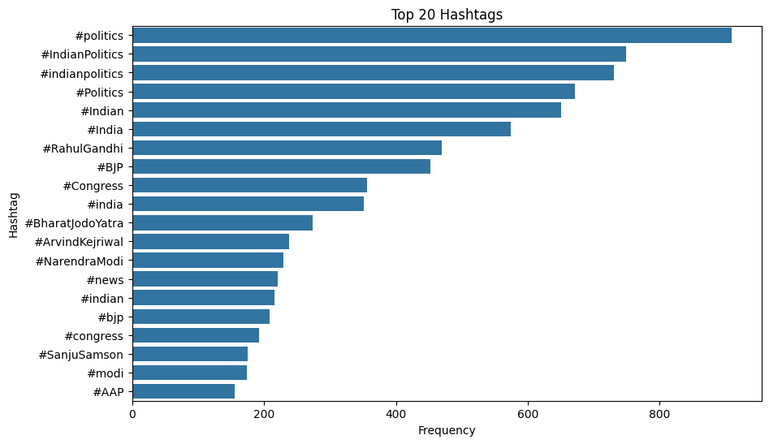
Top 7
Hashtag War

Slide 11
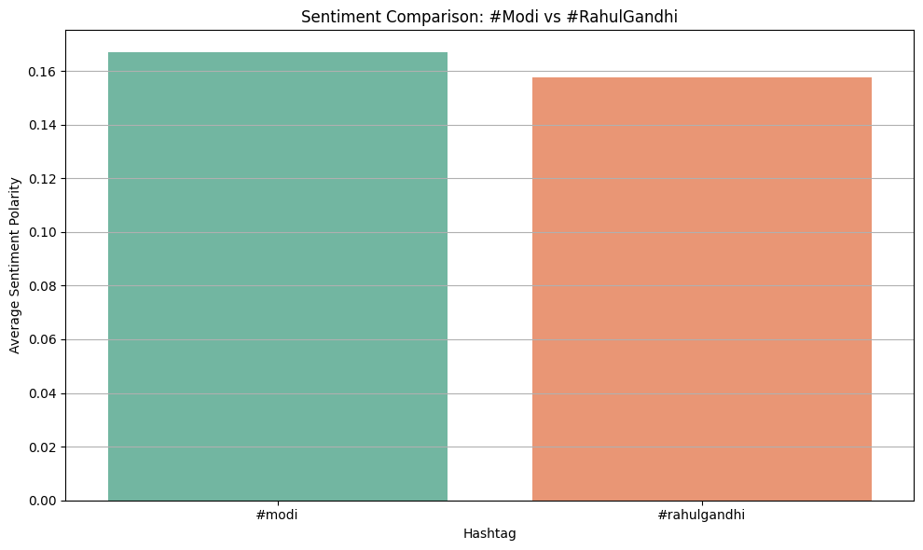
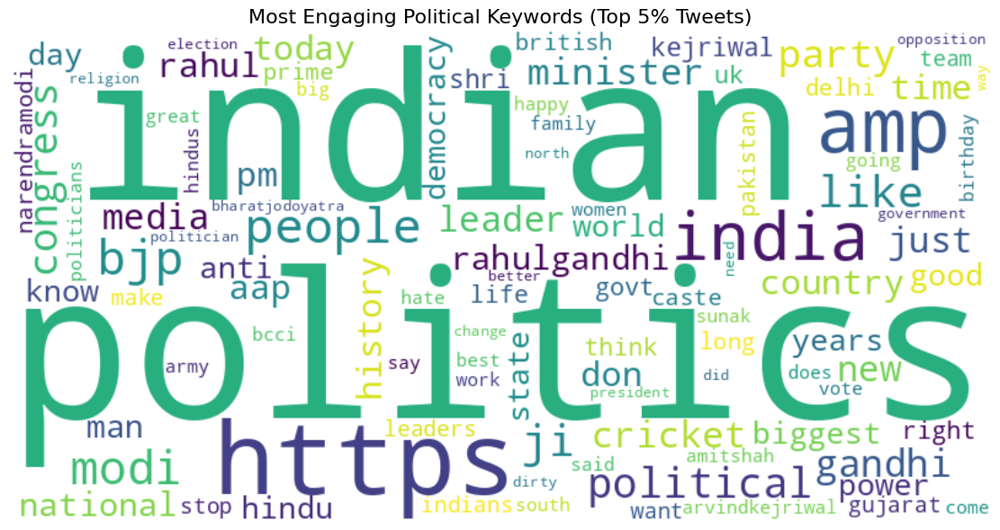
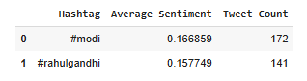
Modi VS Rahul
Engaging Keywords
Although #rahulgandhi has more tweets, the sentiment is
less positive on average.
This suggests that discussions involving #modi are relatively
more favorable or optimistic in tone.

Slide 12




User Behavior
Engagement Patterns
1
Network Affiliations
2
4
Influence Metrics
3
Emotional Expression

Slide 13
Insights & Interpretation
1
Algorithms Amplify
2
Echo Chambers Reinforce
3
Misinformation Spreads

Slide 14
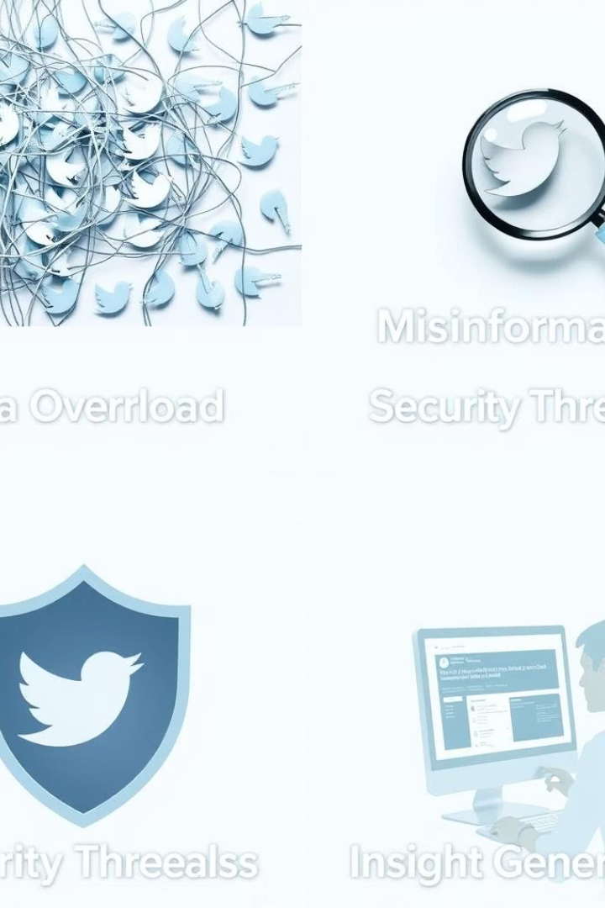



Challenges & Limitations
Potential Data Bias
Limited User Demographics
Skewed datasets can lead to inaccurate insights.
Incomplete profile data restricts comprehensive analysis.
Evolving Algorithms
Platform changes can impact data collection and interpretation.

Slide 15
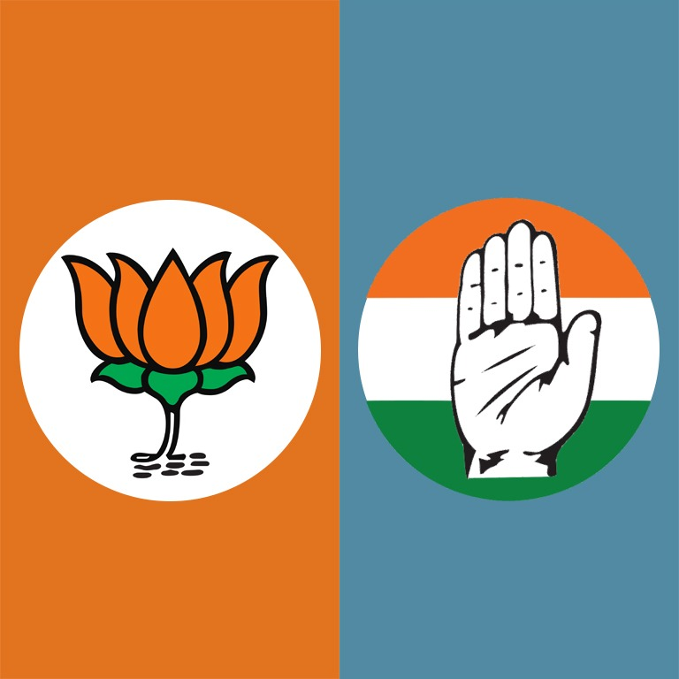
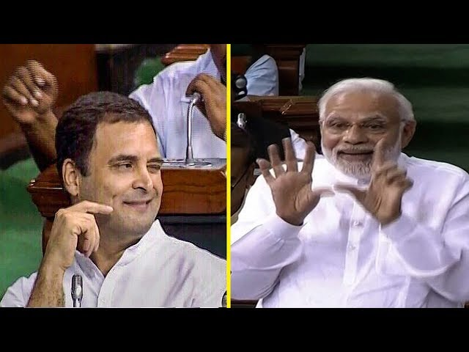
Thank You!

